Slide 1

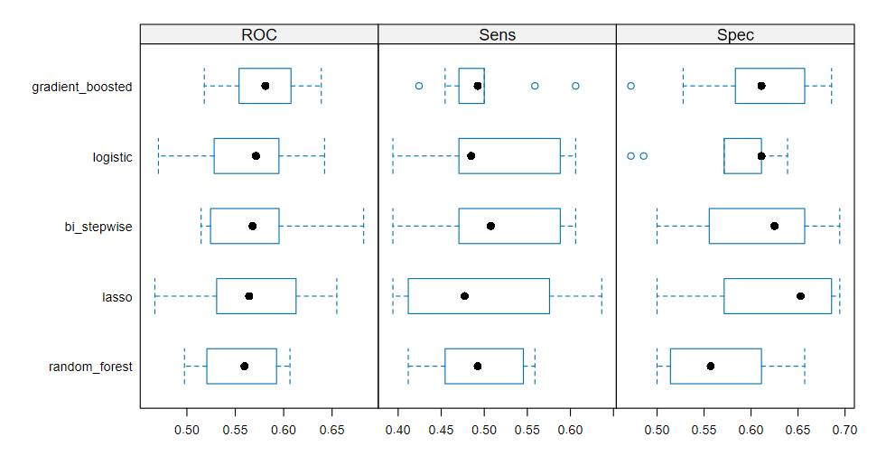
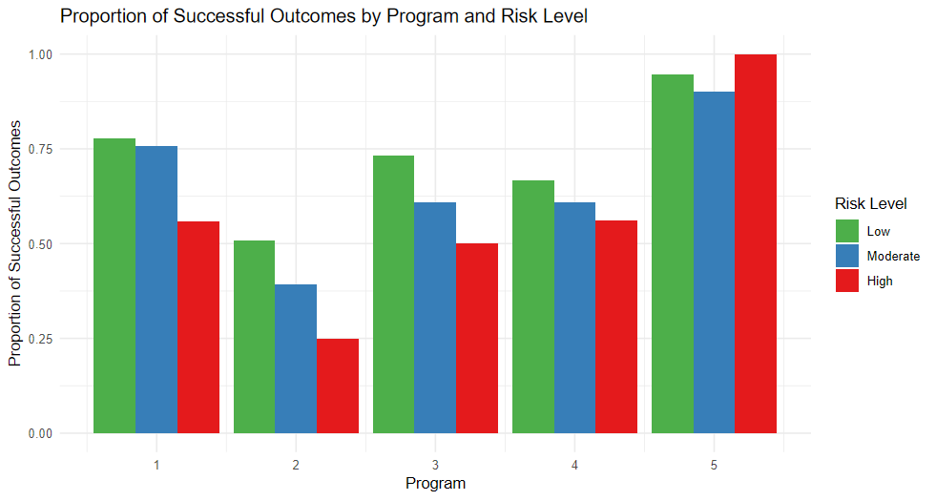
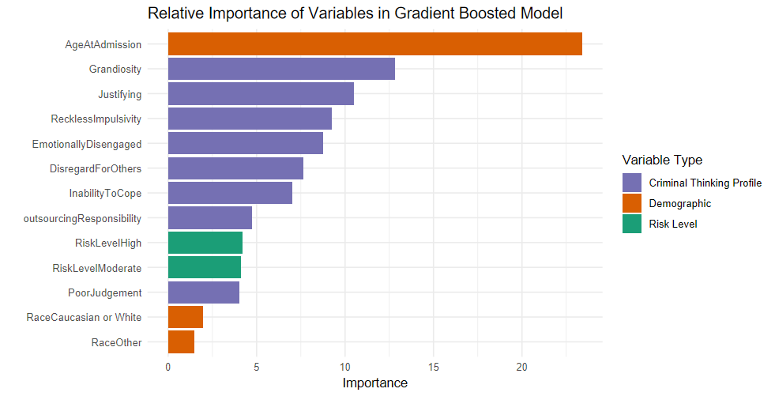
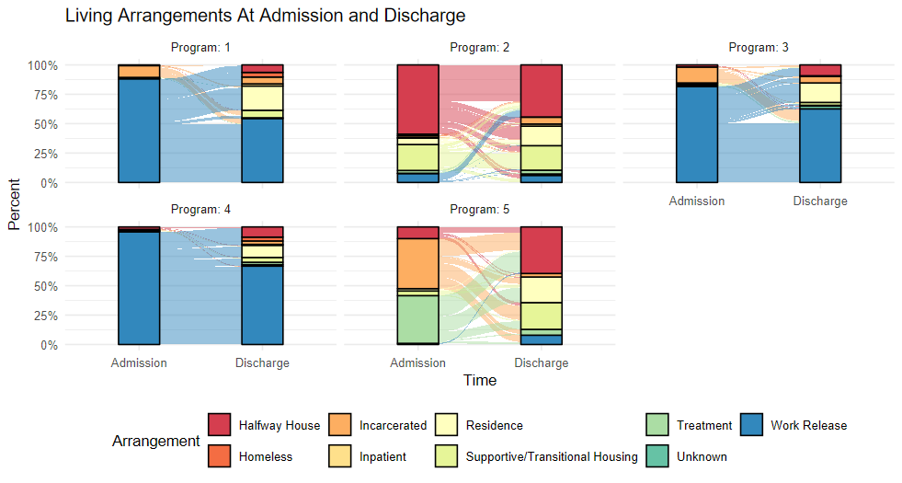
Factors That Relate to Successful Post-Incarceration Outcomes for Individuals in Community Justice Programs in Connecticut
Caleb Henning, Wesleyan University Quantitative Analysis Center, Senior Capstone Project 2025
Introduction
Results & Discussion
Pre-assessed risk level was a consistently significant factor in regression analysis and participants with a high pre-assessed risk level were 59% less likely to successfully leave community justice programs than those with a low pre-assessed risk level (z=-4.5, p < 0.001). Each unit increase in justifying behavior increased participants’ chances of success by 9% (z=2.2, p = 0.02). Participants in Program 5 were 4 times as likely to succeed (z=3.3, p < 0.01), and those in Program 2 were 75% less likely (z=-7.9, p < 0.01), when compared to Program 1.
This analysis was repeated on observations from only Programs 2, 3, and 4 (low-supervision programs) and found similar results. Participants in Programs 2, 3, and 4 with a high pre-assessed risk level were 41% less likely to successfully leave community justice programs than those with a low pre-assessed risk level (z=-2.3, p = 0.02). Each unit increase in justifying behavior increased participants’ chances of success by 12% (z=2.6, p = 0.01). Results align with previous research, which has identified risk level as a negative predictor of successful reintegration (Frisch-Scott & Nakamura, 2022).
Machine learning models were run with 10-fold cross-validation to predict the probability of successful outcomes within low-supervision programs. Gradient boosting was chosen as the best model with the most balanced sensitivity and specificity, and identified age, criminal thinking measures, risk level, and race as the most important variables (Figure 4). However, the results are not promising; with an accuracy of 0.54 [0.46, 0.62], the model only correctly classified 55% of successful participants.
Further research will focus more on machine learning results to understand if other variables would act as better predictors, given the low prediction power of these models. Additionally, programs will be further investigated as a predictor of successful outcomes.
Post-incarceration, many individuals struggle to successfully reintegrate in their communities and end up recidivating. Pre-assessed risk levels and criminal thinking measures have had success in identifying those at risk of recidivating (Frisch-Scott & Nakamura, 2022; Walters, 2016); Black men are often the most likely to fail probation and recidivate (Steinmetz & Henderson, 2016).
This capstone aims to build on the literature by investigating the relationship between pre-assessed risk levels, criminal thinking profiles, demographic variables, and post-incarceration outcomes for individuals participating in community justice programs. My research specifically focuses on how these relationships differ at five of these programs across Connecticut.
Figure 2. Boxplots representing the area under the ROC curve, sensitivity, and specificity for 10-fold cross-validation for 5 models.
Visualizations
Figure 1. This bar graph displays the proportion of successful outcomes for participants across programs and risk levels. Overall, participants are less likely to succeed as their risk level increases (with an exception in Program 5 because of its small sample size). Participants in Program 2 are especially unsuccessful, with a 25% success rate for high-risk individuals.
Figure 2. These boxplots shows the results for 10-fold cross-validation for all five machine learning methods used on the dataset. ROC represents how well the model can distinguish between successful and unsuccessful outcomes, with a ROC of 0.5 indicating that the model is no better than random chance. Sensitivity refers to the rate of true positives and specificity refers to the rate of true negatives identified by the model.
Figure 3. This alluvial graph displays how many participants change living arrangements from admission to discharge. Participants in Programs 5, 1, and 3 have the highest fraction of participants in independent residences at discharge.
Figure 4. This bar graph shows the most important variables identified by the gradient boosting model. This model was only run on Programs 2, 3, and 4, which had the lowest overall success rates out of all the programs. Interestingly, these programs are also the work release programs, which provide participants with the least oversight and highest levels of freedom.
Figure 1. Bar graph displaying the proportion of successful outcomes by program and risk level.
Methods
The dataset used for this project included information from eight different datasets, all combined to include 1340 observations of 72 variables, with 1129 unique participants in the final dataset. The main variables of interest are risk level (low, moderate, high), length of stay (in days), criminal thinking profile measures (0–99, higher values correspond to personality traits associated with crime), and outcomes (successful vs. unsuccessful). Program 1 is residential transitional housing, 2 is scattered site supportive housing, 3 and 4 are residential work release programs, and 5 provides residential treatment for sex offenders.
Two main methods were used to analyze the data: 1) logistic regressions with clustered standard errors, and 2) machine learning models focusing on feature selection. Logistic regressions relied on clustered standard errors because participants could move from program to program, or reenter any of the programs, leading to specific participants having multiple rows of data. Feature selection methods such as lasso, random forest, gradient boosting, and stepwise regressions were run to identify the most important explanatory variables. All models initially included the explanatory variables risk level, age, race, program, eight criminal thinking measures, and suicide risk. Logistic regressions control for all these factors and additionally homicide risk.
Figure 4. Bar graph of variable importance for variables selected by gradient boosted logistic regression model.
References
Frisch-Scott, N. E., & Nakamura, K. (2022). Time for a change: Examining the relationships between recidivism-free time, recidivism risk, and risk assessment. Justice Quarterly,39 (6), 1156–1179. https://doi.org/10.1080/07418825.2021.1957983
Steinmetz, K. F., &, Henderson, H. (2016). Inequality on probation: An examination of differential probation outcomes. Journal of Ethnicity in Criminal Justice, 14 (1), 1–20.https://doi.org/10.1080/15377938.2015.1030527.
Walters, G. D. (2016). Predicting recidivism with the criminal sentiments scale: meta-analysis of putative measure of criminal thought content. Criminal Justice and Behavior, 43(9), 1159-1172.
Figure 3. Alluvial graph representing the proportions of participants who change living arrangements between admission and discharge.
Acknowledgements: I would like to thank Professor Jen Rose and Professor Val Nazzaro for their support with this project.

